Slide 1
University Record Management System
Done by

Slide 2
Introduction
Records management (RM) is the practice of controlling records of an organization from the time they are created to the time of disposal which includes identifying, creating, classifying, using, storing. securing, retrieving, and destroying or permanently preserving records. It also allows for the timely destruction of records that are non-essential so that we may minimize litigation risks, reduce operating costs, and improve organization.
All University employees are responsible for managing the records in their custody. The University-wide Records Management Principles provide guidance for employees to support their records management efforts.

Slide 3
Aim of project
At this project we aim to create a University Record Management system that can be used to register students and conform them registration requests.
This system is useful at it can facilities the university’s employee job

Slide 4
Language used
HTML
CSS
PHP
JavaScript

Slide 5
Project Description
Our project consists of tow sides (Side of admin and side for the student) admin side consists of seven main pages
Login
Dashboard
approve payments
Crete course
Create user
Create semester
Logout

Slide 6
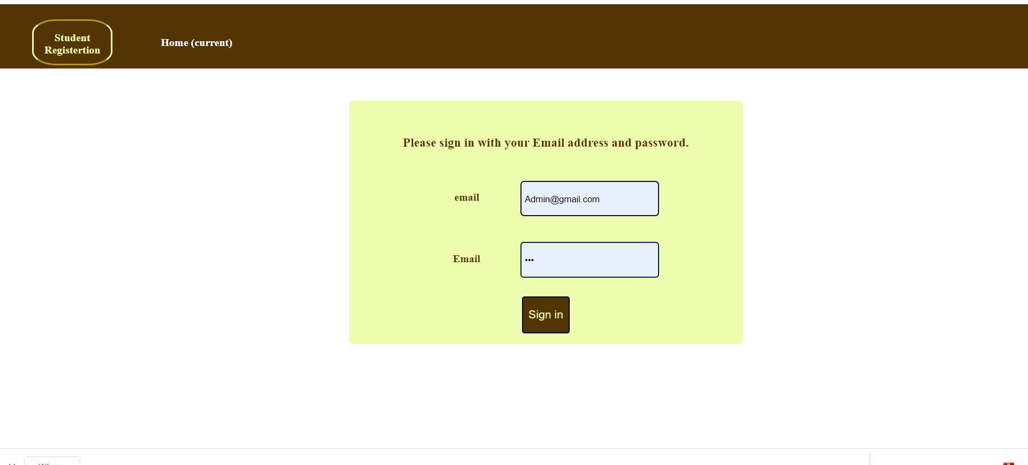
Login Page

Slide 7
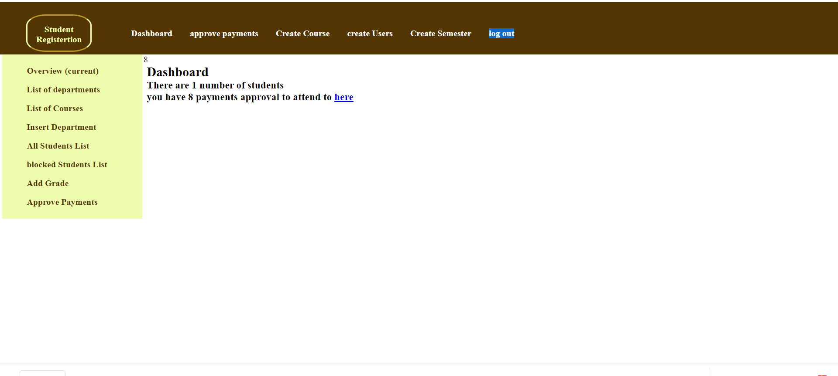
Dashboard Page

Slide 8
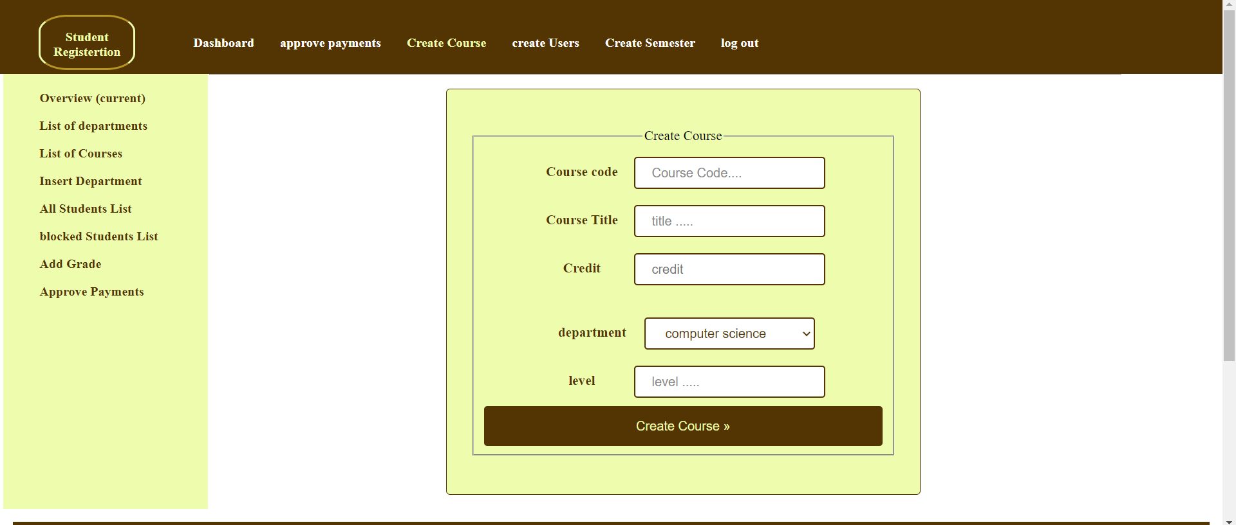
Create course Page

Slide 9
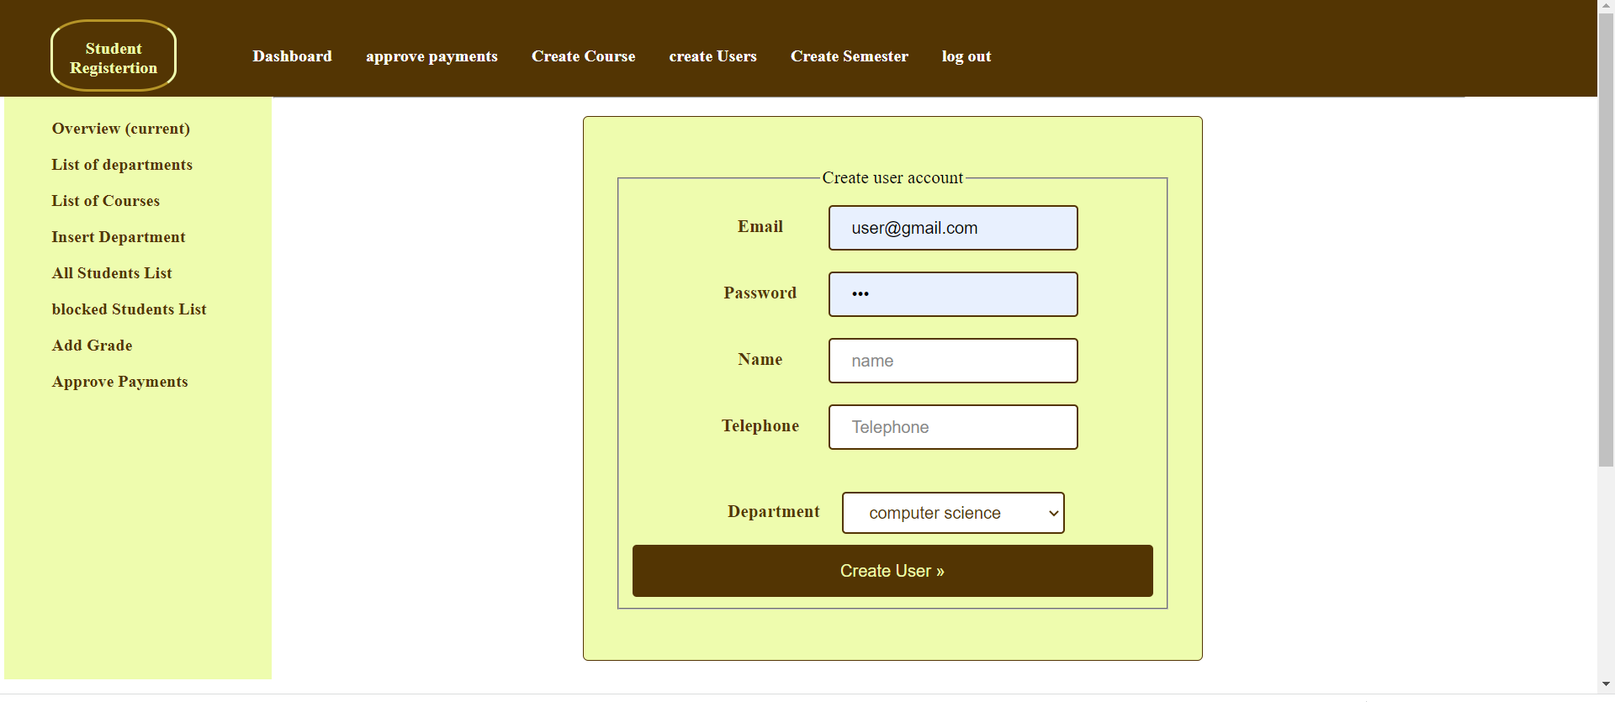
Create users Page

Slide 10
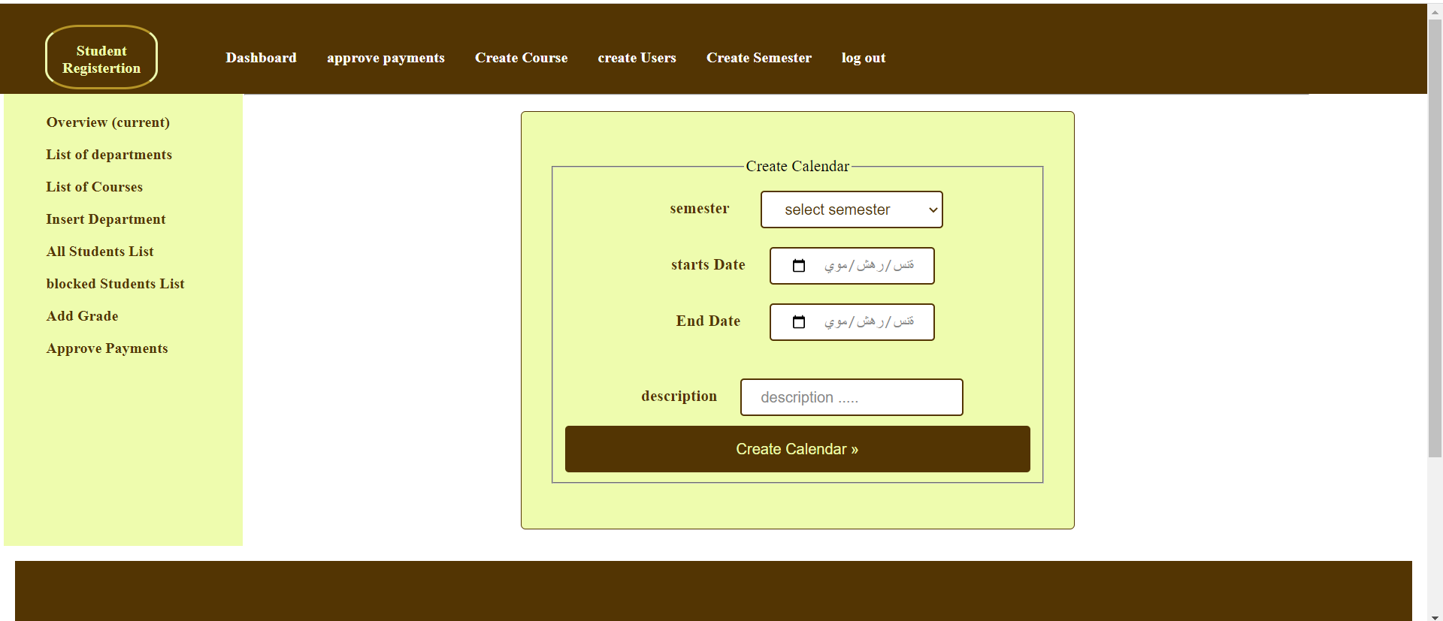
Create semester page

Slide 11
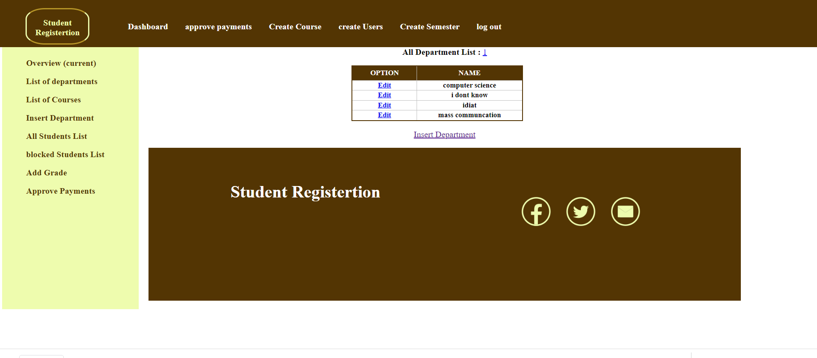
List department page

Slide 12
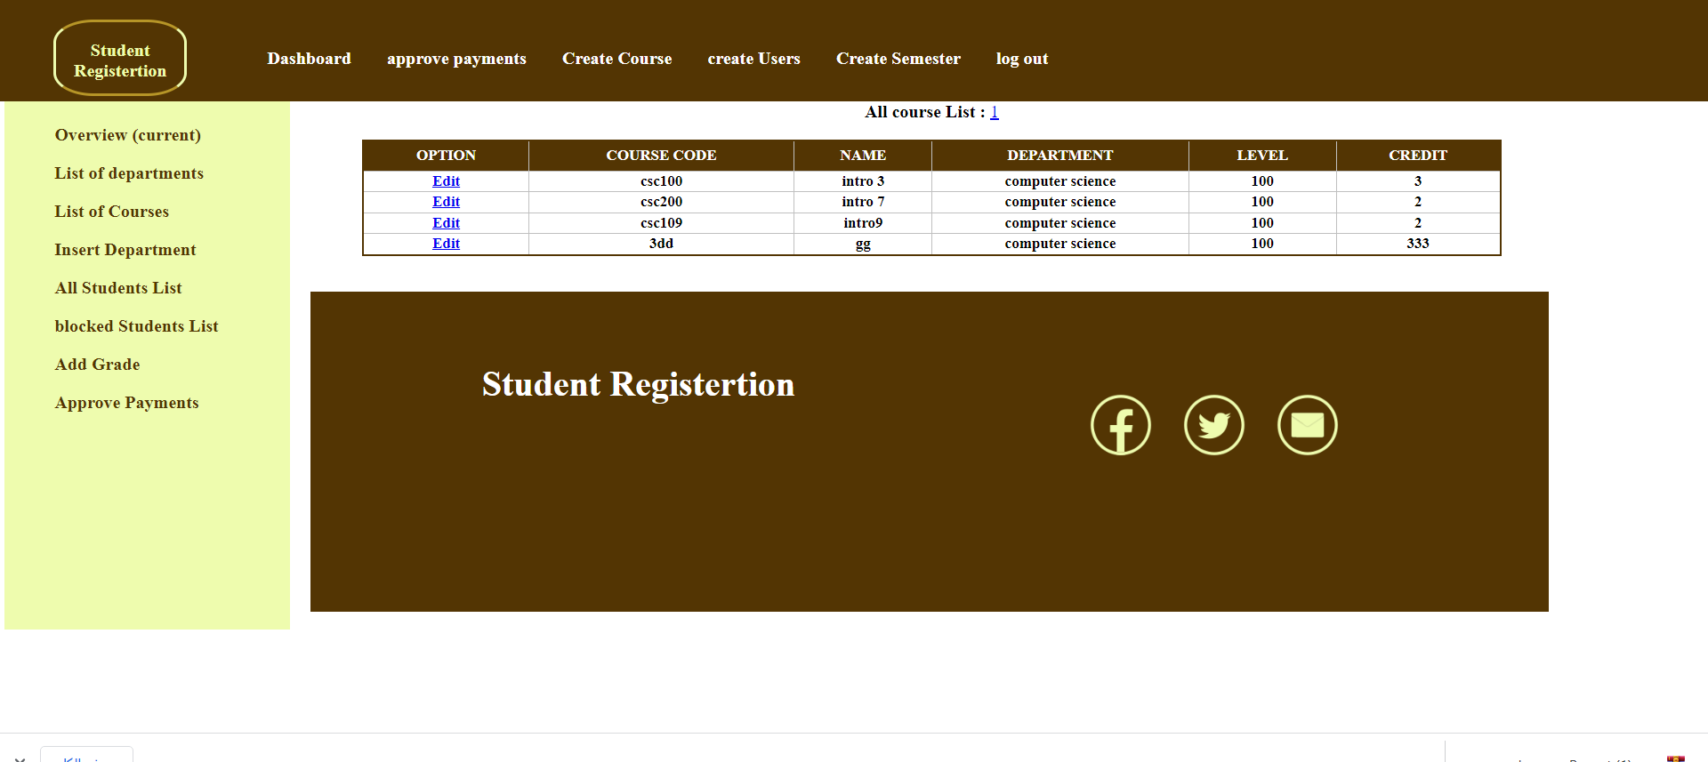
List courses page

Slide 13
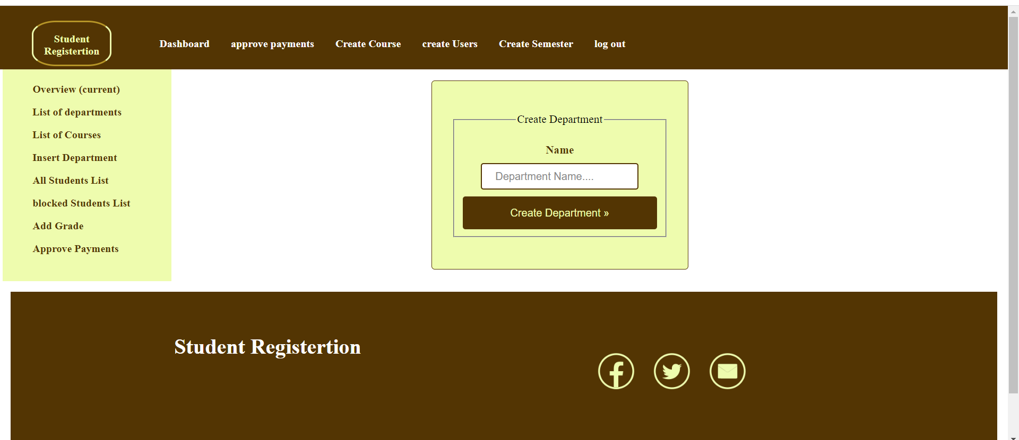
Insert department page

Slide 14
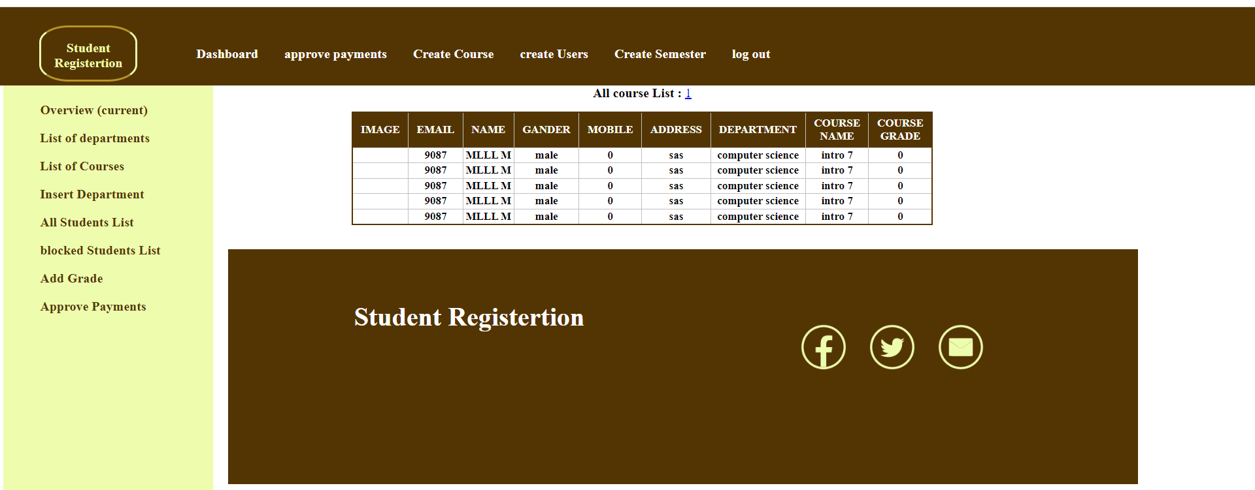
List all students

Slide 15
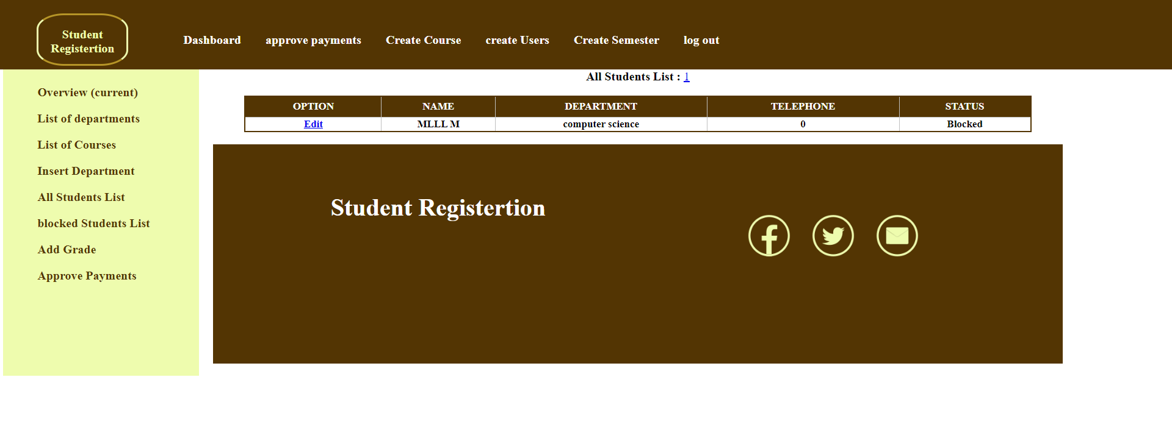
List of blocked students

Slide 16
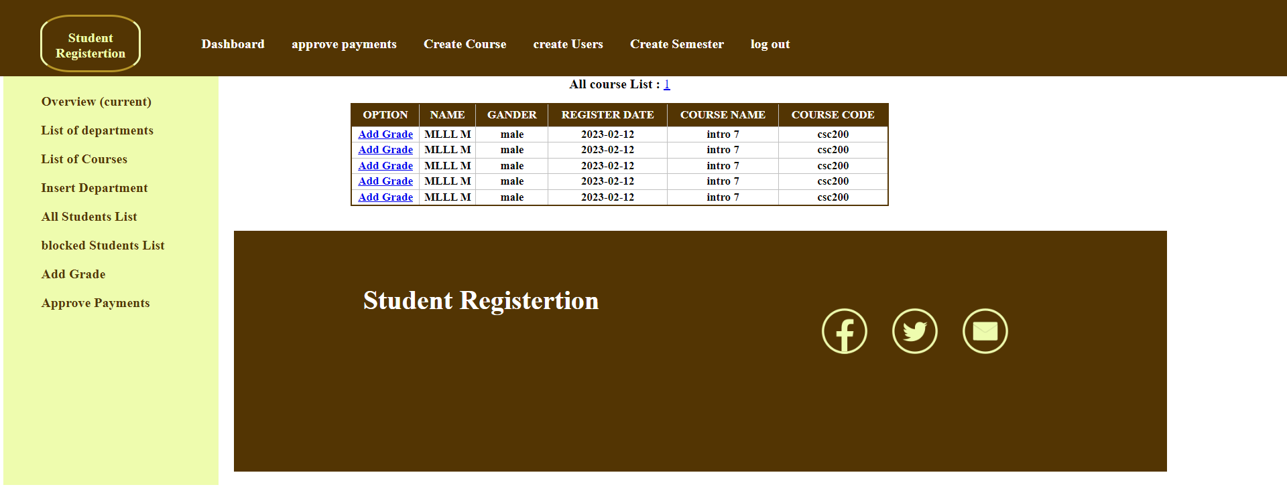
Add grade Page

Slide 17
Project Description
Our project consists of tow sides (Side of admin and side for the student) the student side consists of these pages
Home
Register
Confirm Registration
Login

Slide 18
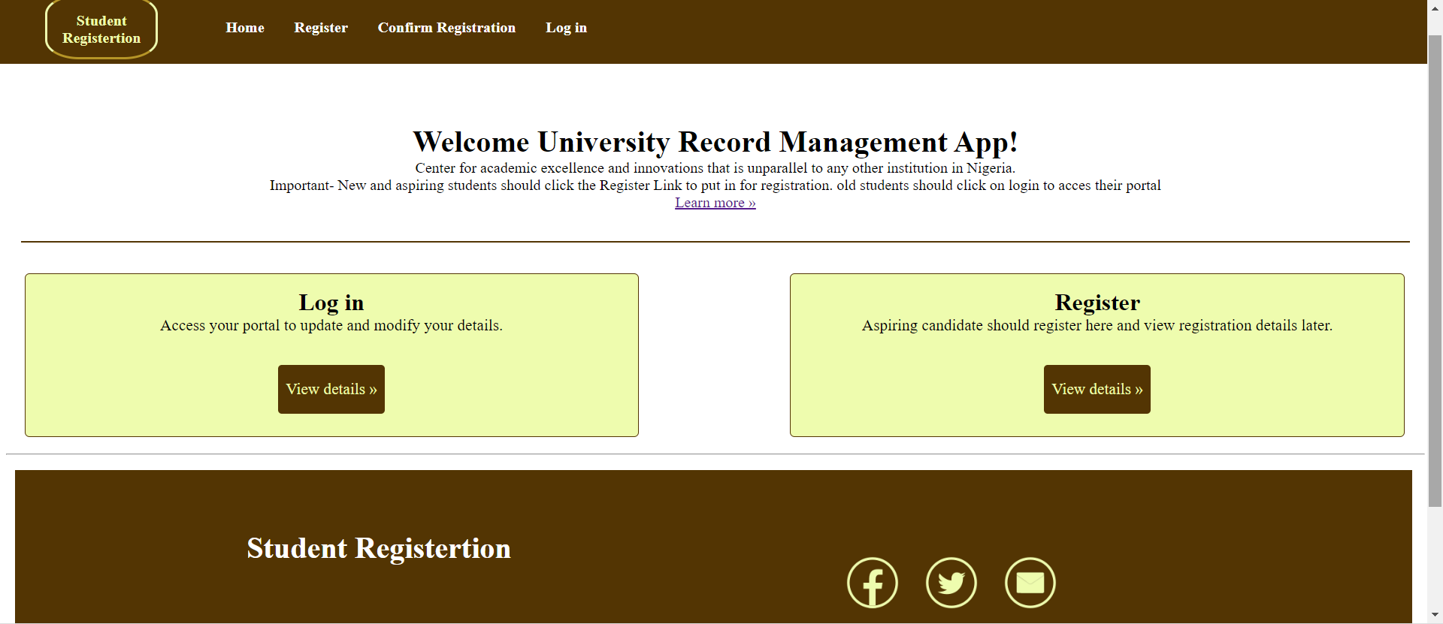
Home page

Slide 19
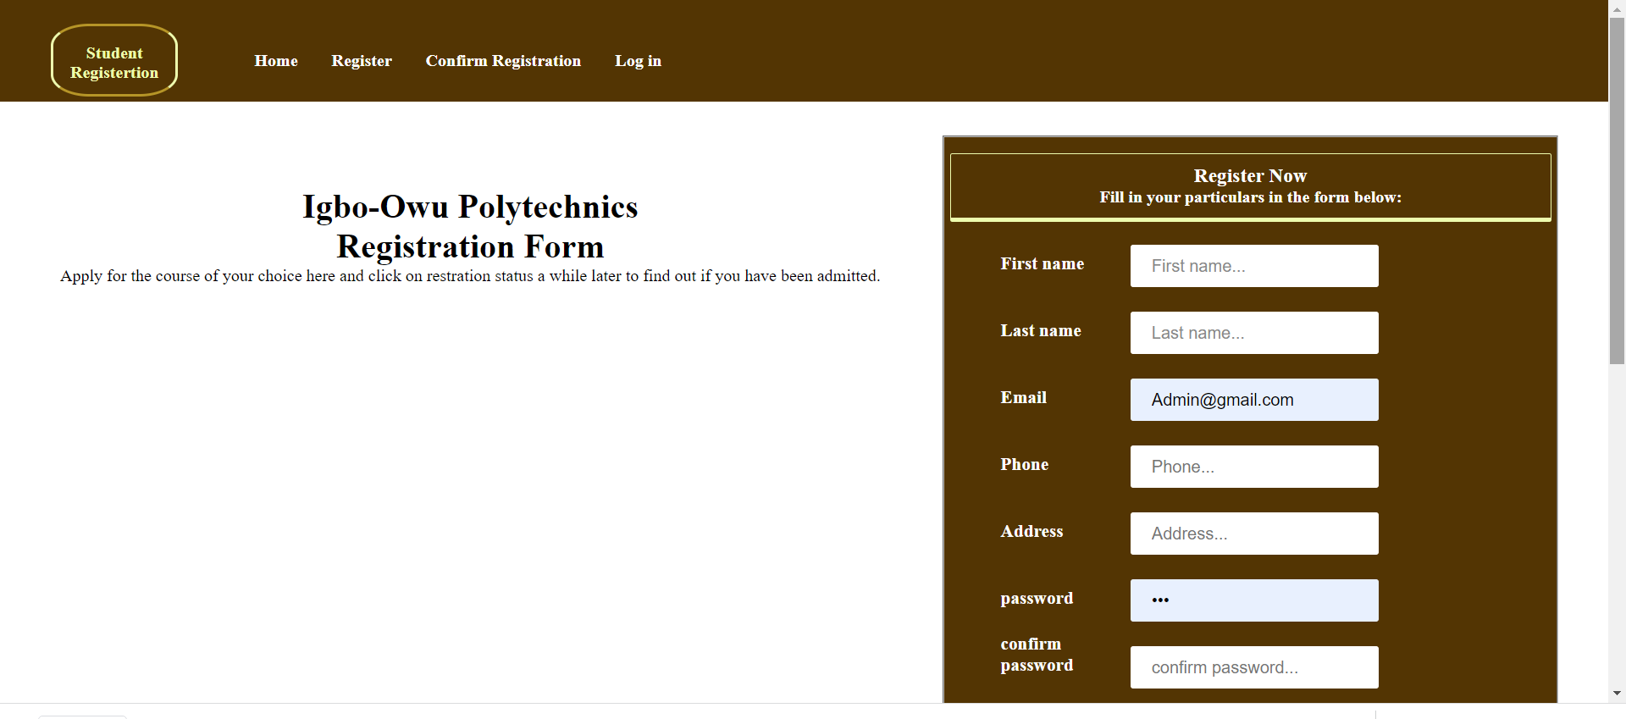
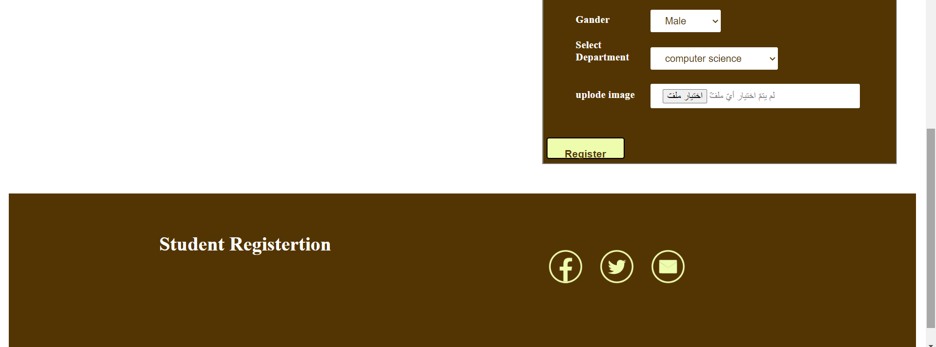
Register page

Slide 20
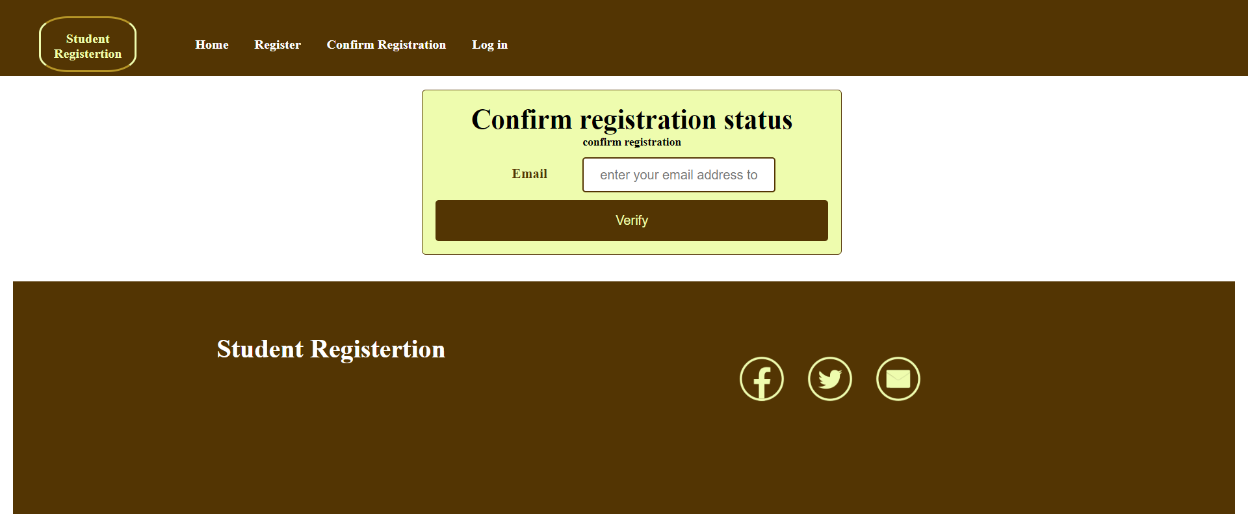
Confirm Registration page

Slide 21
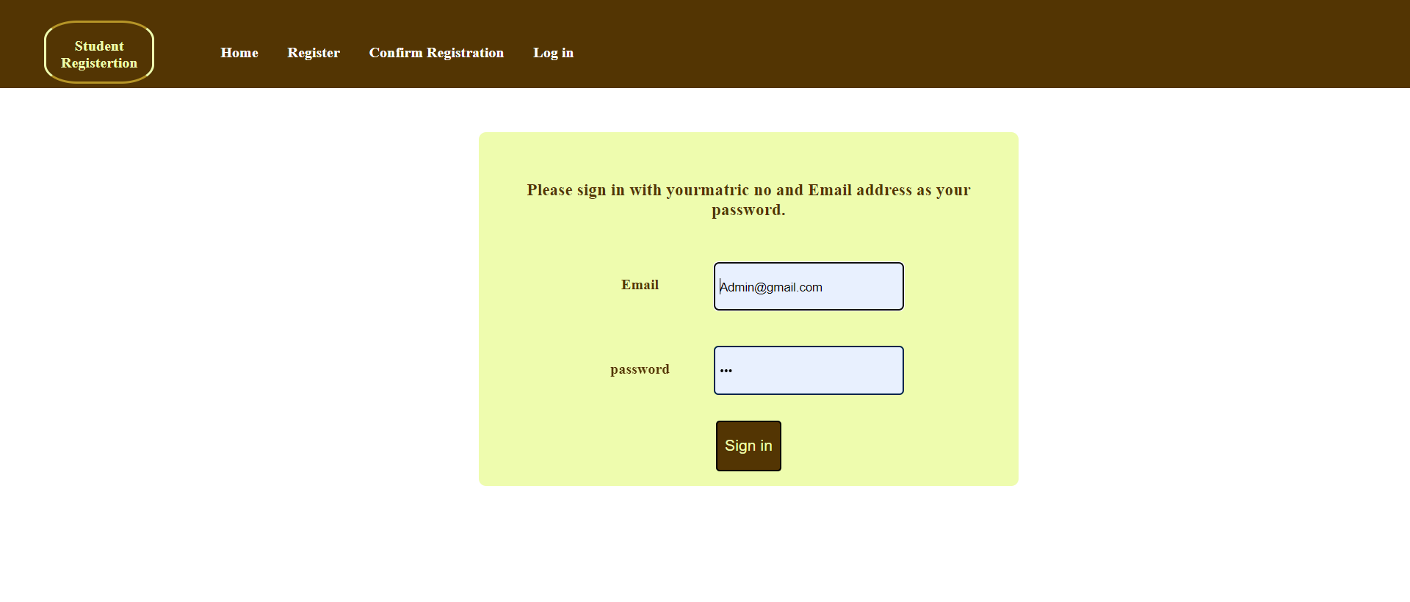
Login page

Slide 22
Conclusion
The project was carried out in order to solve the problem of the faculty about records of the students. Accordingly, the idea of design and implementation of a computerised system for university was very helpful and efficient as compared to the traditional method of record keeping. Benefits to the staffs include; ease of use, time saving, easy retrieval and creation of reports.

Slide 23
THANKS

